Slide 1
 | FACT SHEET – Page 1
 | Collaborative Hydraulics: Advancing to the Next Generation of Engineering (CHANGE)
& STIC Annual Meeting
STIC PROJECT TITLE Every Day Counts: CHANGE VTRANS CONTACT(S) Nick Wark, Hydraulics Engineer MORE INFORMATION https://www.fhwa.dot.gov/innovation/everydaycounts/edc_4/change.cfm Scott Hogan FHWA Resource Center (720) 576-6026 Scott.Hogan@dot.gov This fact sheet was prepared for the 2017 VTrans Research Symposium & STIC Annual Meeting held on September 28, 2017 at National Life in Montpelier, VT. 8:00 am – 12:00 pm. Fact sheets can be found for additional projects featured at the 2017 Symposium at http://vtrans.vermont.gov/planning/research/2017symposium Additional information about the VTrans Research Program can be found at http://vtrans.vermont.gov/planning/research Additional information about the VTrans STIC Program can be found at http://vtrans.vermont.gov/boards-councils/stic | Why CHANGE? Next-generation hydraulic tools improve understanding of complex interactions between river environments and transportation assets, enabling better design and more efficient project delivery. The current generation of hydraulic modeling tools– primarily one-dimensional (1D) modeling–has been in use for nearly 60 years. User interfaces have greatly improved during this time, but the underlying techniques have remained the same. These modeling techniques apply several simplifying assumptions that can lead to overly conservative, inadequate, or inaccurate results and are insufficient to meet new requirements. For example, in recent years, resource agencies have increased their focus on assessment of environmental impacts associated with river crossings. As a result, hydraulic engineers have become responsible for demonstrating that impacts have been avoided or minimized to the extent possible. Traditional hydraulic tools do not effectively support these levels of inquiry and analysis. Next-Generation Hydraulic Modeling Tools The next generation of hydraulic engineering tools, particularly two-dimensional (2D) modeling and graphical visualization features, allows users to create better representations of the often complex interaction between transportation assets and the riverine or coastal environments. These representations provide the planning and design team with better data with which project quality can be improved. The technology can be used to locate and illustrate patterns of flow discharge, water surface elevations, depth, velocity and shear stress. The results allow for more accuracy in estimating flow conditions and flow paths, evaluating hydraulic considerations (including floodplain extent based on Executive Order 13690: Establishing a Federal Flood Risk Management Standard) and assessing climate change or extreme weather event scenarios. These tools also provide realistic 3D graphical representations of anticipated hydraulic conditions, aiding the hydraulic design as well as structural, geotechnical and environmental design components. The 3D representations enhance communication with regulatory bodies and other stakeholders, improving collaboration and ultimately reducing project delivery times. Next-generation hydraulic modeling tools represent a significant evolution in hydraulic modeling theory and practice, with real potential for reducing environmental, regulatory, engineering and other impediments to project delivery. The results can significantly improve the ability of highway agencies to design safer, more cost-effective and resilient structures on waterways.
2017 Research
Symposium

Slide 2
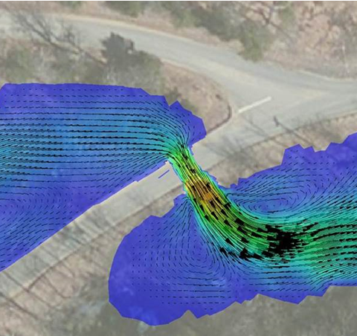
 | FACT SHEET – Page 2
 | Collaborative Hydraulics: Advancing to the Next Generation of Engineering (CHANGE)
& STIC Annual Meeting
STIC PROJECT TITLE Every Day Counts: CHANGE VTRANS CONTACT(S) Nick Wark, Hydraulics Engineer MORE INFORMATION https://www.fhwa.dot.gov/innovation/everydaycounts/edc_4/change.cfm Scott Hogan FHWA Resource Center (720) 576-6026 Scott.Hogan@dot.gov This fact sheet was prepared for the 2017 VTrans Research Symposium & STIC Annual Meeting held on September 28, 2017 at National Life in Montpelier, VT. 8:00 am – 12:00 pm. Fact sheets can be found for additional projects featured at the 2017 Symposium at http://vtrans.vermont.gov/planning/research/2017symposium Additional information about the VTrans Research Program can be found at http://vtrans.vermont.gov/planning/research Additional information about the VTrans STIC Program can be found at http://vtrans.vermont.gov/boards-councils/stic | State of the Practice Technology developments in recent years have led to an expanding market of hydraulic modeling programs and tools that are available to the transportation community and can be applied nationally. While 1D modeling is the dominant practice nationwide, almost half of the country’s state departments of transportation are currently either exploring, evaluating or using 2D bridge hydraulic modeling. The Federal Highway Administration (FHWA) has recognized the benefits of 2D modeling for the safety of the traveling public and in the resilience of transportation infrastructure. This has resulted in guidance and training encouraging its use, including Hydraulic Design of Safe Bridges (HDS 7), Evaluating Scour at Bridges (HEC-18), and Two-Dimensional Modeling of Rivers at Highway Encroachments (FHWA-NHI-135095). Through round four of Every Day Counts (EDC-4), the FHWA plans to provide additional resources to help states advance their state of practice, including training on modeling software use and how to communicate the results to stakeholders and customers effectively, technical guidance resources on best-practice modeling techniques, user forums and other means of peer exchange for modelers and reviewers, and technical modeling assistance with a limited number of design projects. Benefits Improved Quality and Resiliency. Better representations provide planning and design teams with better data, leading to improved project quality. Enhanced Collaboration. 3D graphical visualizations derived from 2D modeling offer better tools for communicating the often complex interaction between waterways, the transportation infrastructure, and the surrounding environment. Streamlined Delivery. Improved collaboration through 2D and 3D visualizations offers real potential for reducing environmental, regulatory, engineering and other impediments to project delivery. Applications of Next-Generation Hydraulic Design Tools Complex bridge crossings Analysis of bridge options Complex floodplain geometry Flood risk assessment Flood mapping Channel restoration Fish habitat analysis Sediment transport analysis Bridge scour analysis Channel stability analysis Scour countermeasure analysis
2017 Research
Symposium

